Slide 1
JavaScript
Abby Chou

Slide 2
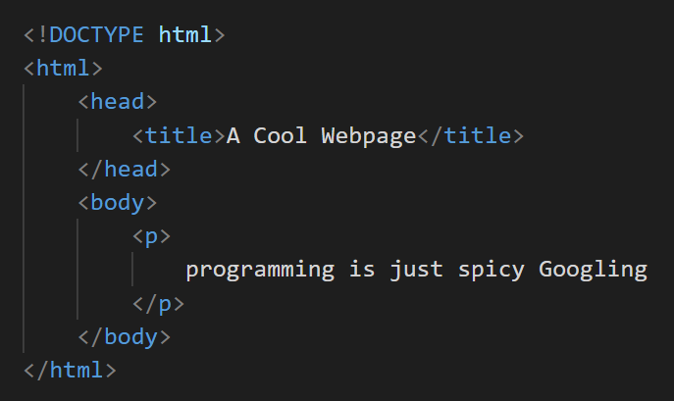
Recap
HTML
Describes content and structure
What exists? How is it organized?
Notes:
These together make a static website. No interaction, can’t do more.

Slide 3
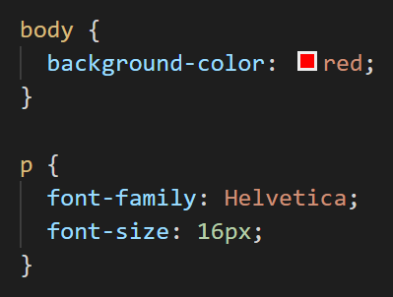
Recap
HTML
Describes content and structure
What exists? How is it organized?
CSS
Describes the presentation
Colors! Fonts! Alignment, margins, borders, shading, and more
Notes:
These together make a static website. No interaction, can’t do more.

Slide 4
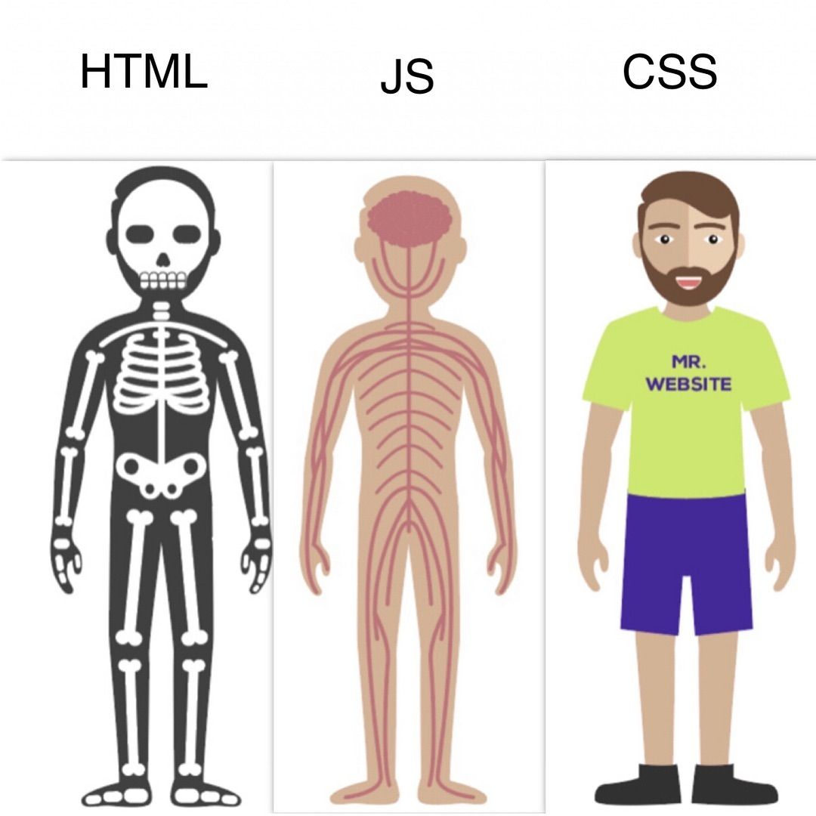
JavaScript is...
... not related to Java 🙃
... a programming language that manipulates the content of a web page
... how we take HTML + CSS and make it interactive!
... used by a vast majority of websites and web applications
Notes:
... a programming language that manipulates the content of a web page
... how we take HTML + CSS and make it interactive!
... used by a vast majority of websites and web applications
Unrelated to java
Can click, use mouse, etc. Lets website respond.
Looks like “standard programming language”

Slide 5
Where does it go?
Where can we run JavaScript code?
The browser console
Windows
Chrome: Ctrl + Shift + J
Firefox: Ctrl + Shift + J
Mac
Chrome: Cmd + Option + J
Firefox: Cmd + Shift + J
Tied to our HTML file (more on that later!)
Notes:
Pull up the console to demonstrate

Slide 6
How to JavaScript

Slide 7
Types
JavaScript has 5 primitive data types:
Boolean (true, false)
Number (12, 1.618, -46.7, 0, etc.)
String (“hello”, “world!”, “12”, “”, etc.)
Null
Undefined
Notes:
Number - pos neg, integer, decimal
String - denoted by quotes. Can have empty string
Null and undefined sound familiar, but there is a difference, which i will talk about in a bit.

Slide 8
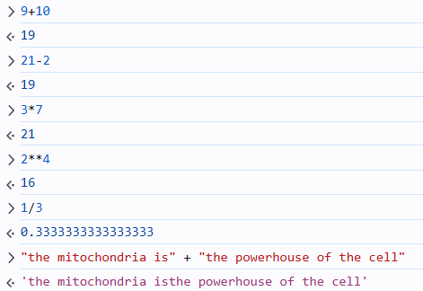
Operators
Things (mostly) work how you would expect:
arithmetic operators
Notes:
Arithmetic operators
Comparison operators
Note triple equal sign
for a ✨fun✨ demonstration of JavaScript being dumb, check out https://www.destroyallsoftware.com/talks/wat

Slide 9
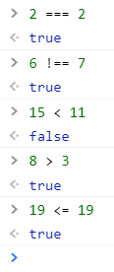
Operators
Things (mostly) work how you would expect:
(note the triple equals sign!)
arithmetic operators
comparison operators
Notes:
Arithmetic operators
Comparison operators
Note triple equal sign
for a ✨fun✨ demonstration of JavaScript being dumb, check out https://www.destroyallsoftware.com/talks/wat

Slide 10
Why we don’t use ==
In most programming languages, we use == to compare whether two values are equal.
What’s 2 == 2 ? (True or False)
What’s 2 == “2” ? (True or False)
We generally want 2 == “2” to be false, since they’re different data types!
But JS doesn’t do this…
Notes:
It performs type coercion (i.e. forces the arguments to be of the same type before comparing them)

Slide 11
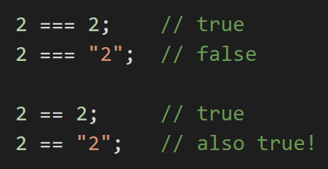
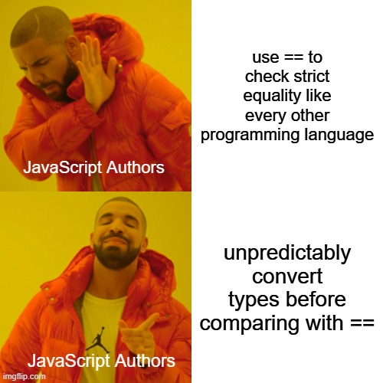
Why we don’t use ==
In JavaScript, == performs type coercion (i.e. forces the arguments to be of the same type before comparing them)
tl;dr don’t use ==
Notes:
It performs type coercion (i.e. forces the arguments to be of the same type before comparing them)

Slide 12
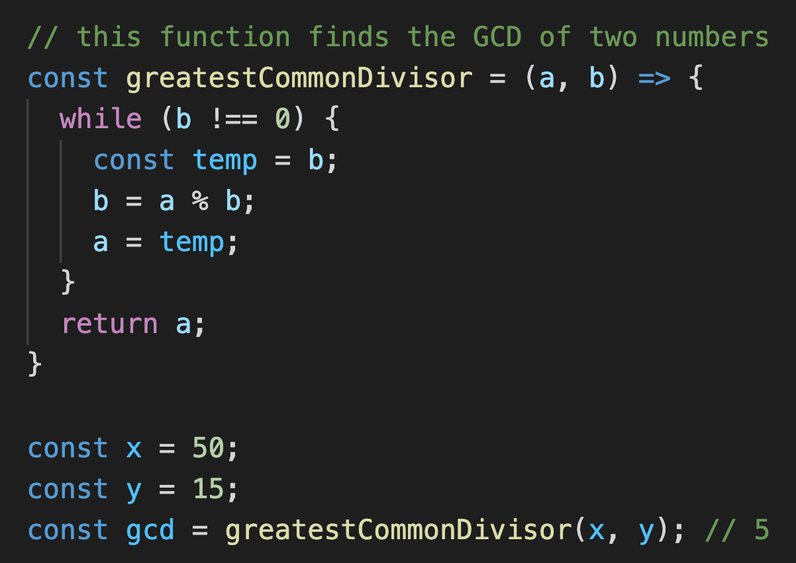
Basic Syntax
Every statement in JavaScript ends with a semicolon;
Whitespace is ignored. (but can improve readability)
Curly braces denote where blocks begin and end.
These are comments.
It doesn’t affect how the code runs, but you should use them to keep your codebase readable!
Notes:
Semicolons - not actually necessary, but using them really improves readability and prevents bugs
Whitespace - can remove or add
Curly braces - blocks
Comments
for a ✨fun✨ demonstration of JavaScript being dumb, check out https://www.destroyallsoftware.com/talks/wat

Slide 13
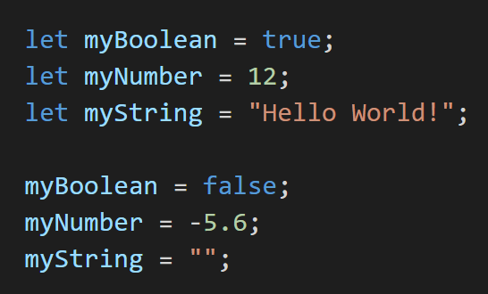
Defining variables
Notes:
Single equals for variables,
Name that we can “give” a value
In javascript, when you first use a variable, you have to declare it
We use the “let” keyword to declare variable. After this, we can freely change the value
Note: Javascript conventions name variables using camelCase. Every word capitalized except for first.
note: re-declaring a variable with “let” when the variable already exists does not work in strict mode, but it runs without error in non-strict mode

Slide 14
Defining variables
JavaScript convention is to name variables using camelCase.
Notes:
Single equals for variables,
Name that we can “give” a value
In javascript, when you first use a variable, you have to declare it
We use the “let” keyword to declare variable. After this, we can freely change the value
Note: Javascript conventions name variables using camelCase. Every word capitalized except for first.
note: re-declaring a variable with “let” when the variable already exists does not work in strict mode, but it runs without error in non-strict mode

Slide 15
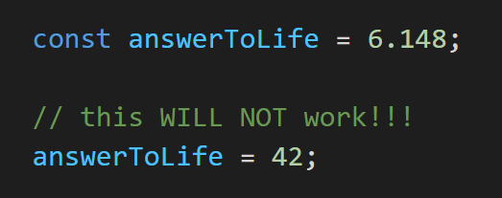
Defining constants
To define a variable which cannot be re-assigned later:
Notes:
Javascript also have constants

Slide 16
let vs. const
Why bother using const when let exists?
Notes:
Why bother?
Safe code practice. Things that shouldn’t change can’t change. E.g. conversion factor

Slide 17
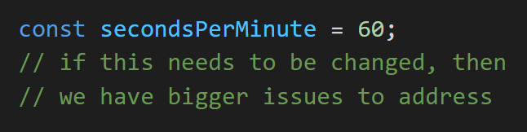
let vs. const
Why bother using const when let exists?
Safe code practices! If something should never be changed, don’t let it change :)
Notes:
Why bother?
Safe code practice. Things that shouldn’t change can’t change. E.g. conversion factor

Slide 18
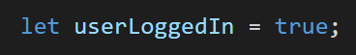
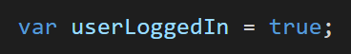
let vs. var
tl;dr please don’t use var
Notes:
For people who have seen or used js before, may have seen var. Will see code snippets that use it. Short answer is don’t var.
Let was added to js because var would have unexpected behavior. (let has same behavior as other languages)

Slide 19
let vs. var
tl;dr please don’t use var
technical details (Google it if you’re interested):
let is block-scoped
var is function-scoped This type is like global variable, but in modern js we merely use it
let exists because people kept getting bugs when trying to use var
Notes:
For people who have seen or used js before, may have seen var. Will see code snippets that use it. Short answer is don’t var.
Let was added to js because var would have unexpected behavior. (let has same behavior as other languages)

Slide 20
Questions?

Slide 21
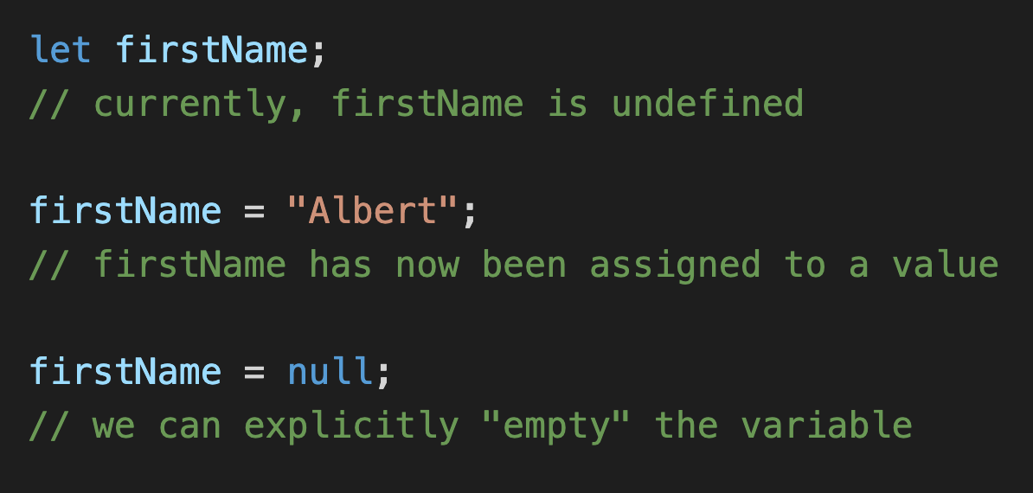
null vs. undefined
undefined means “declared but not yet assigned a value”
null means “no value”
Notes:
Undefined: default value
null: use null to clear a variable. Specifically saying variable is now empty.

Slide 22
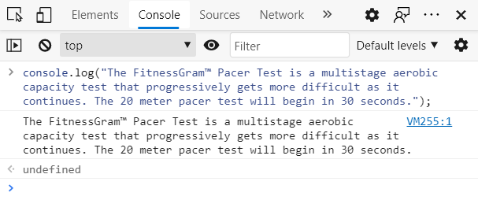
Output
console.log() writes to the JavaScript console:
input
output
Notes:
We often want output.
Prints whatever is given as input to the function.
Equivalent to print functions in other languages.
Why would u use it

Slide 23
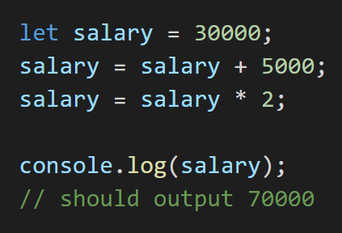
Output
Handy for quick debugging!
Notes:
Used for general debugging purposes

Slide 24
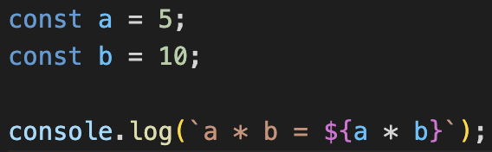
Output
Can also console log with template strings for more descriptive logging

Slide 25
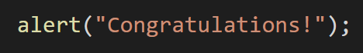
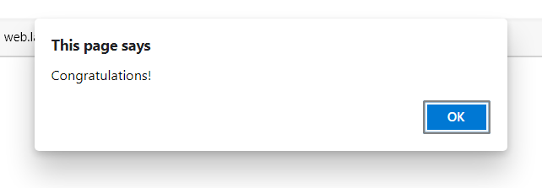
Alerts
alert() generates a pop-up notification with the given content.
Notes:
Another way to provide output is alert. Generates popup notification.

Slide 26
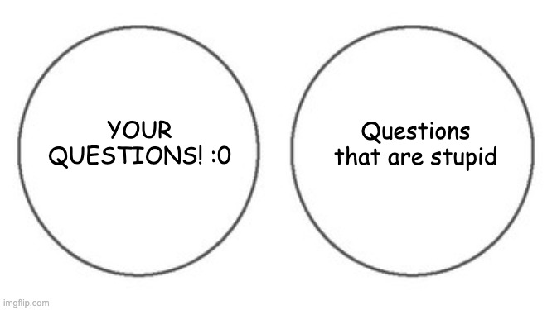

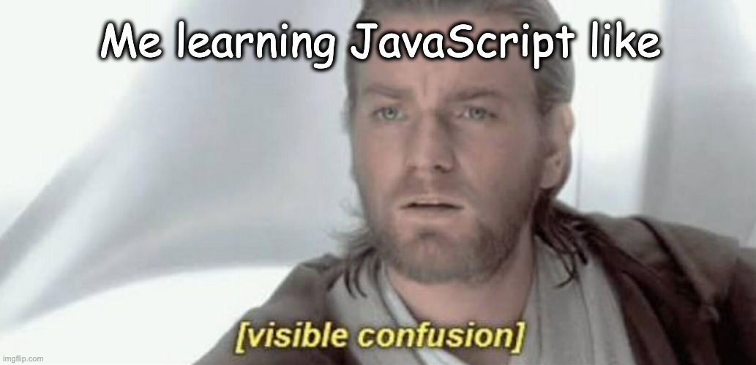
Questions?

Slide 27
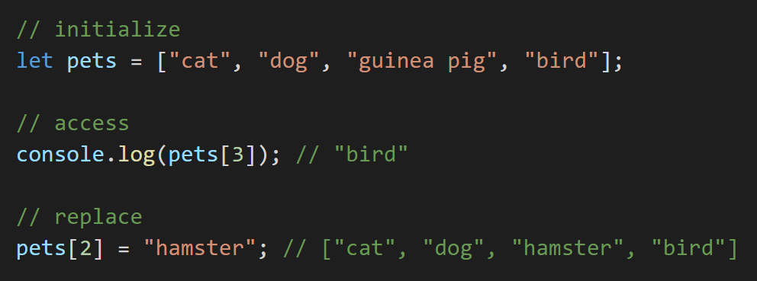

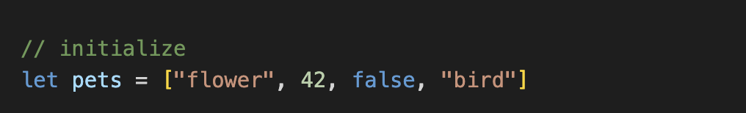
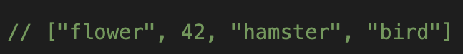
Arrays
For when you want to store a sequence of (ideally similar) items:
Notes:
Up to this point we were talking about primitive data types, here we will start combining them into larger data structures.
Initialize array. Possible to mix types, but generally don’t need to and shouldn’t.
Access element in array, third element
- explain zero-index, and why it will be bird
Replace element in array - can put the element on LHS like a variable

Slide 28
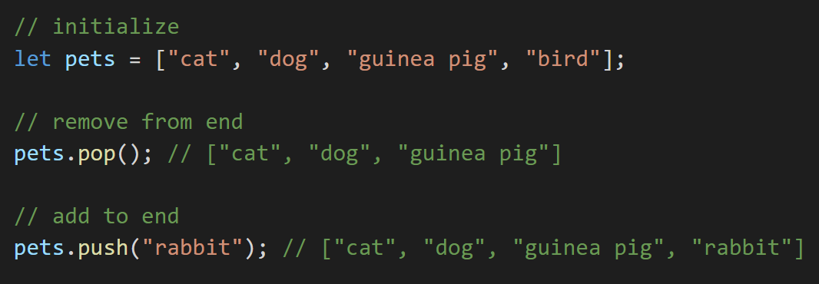
Arrays
Notes:
We will also often want to remove from the end
And add to the end
Lots of other commands to add and remove, like splice

Slide 29
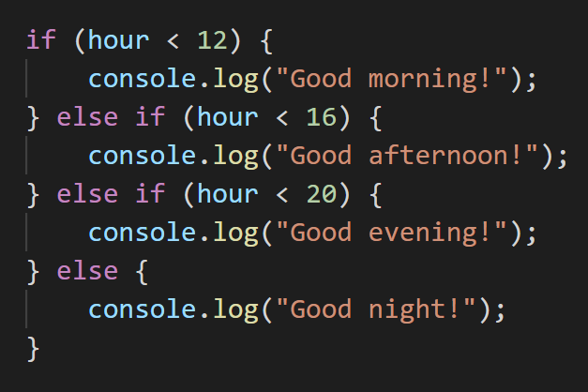
Conditionals
We often want to perform different actions in response to different conditions.
For this, we use the conditional operators if, else, and else if:
Notes:
Works like in english
If this is true, do this. Otherwise, if …
Python uses elif
Indents not necessary, but we use them to keep code cleaner and organized

Slide 30
Conditionals
We often want to perform different actions in response to different conditions.
For this, we use the conditional operators if, else, and else if:
Note the indent (tab)!
It’s not necessary, but it will make your code much more readable.
Notes:
Works like in english
If this is true, do this. Otherwise, if …
Python uses elif
Indents not necessary, but we use them to keep code cleaner and organized

Slide 31
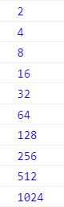
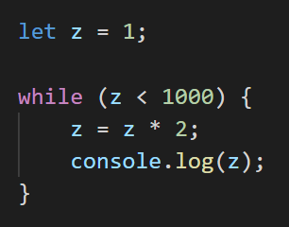
While loops
What if we want to repeat an action as long as some condition is satisfied?
Notes:
While loop runs a certain block of code as long as a condition is satisfied
What does this code print?
It does print out 1024, check after block.
Be wary of syntax: parentheses and curly braces, which might be different from the language you’re coming from.

Slide 32
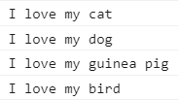
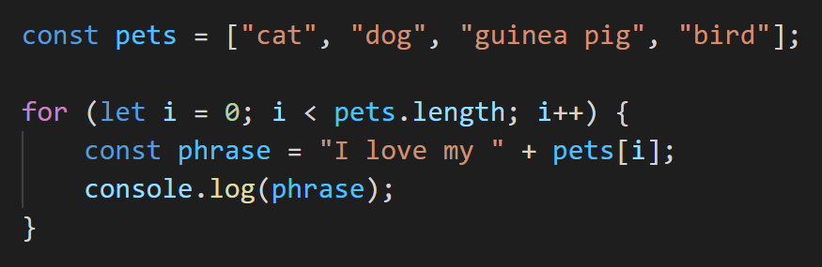
For loops
Useful when we want to iterate through indices:
Notes:
Same array as before
For loop works as follows:
- create an index variable i that starts off as 0
- second chunk is the condition that the loop will check before every step
- third section (i++) shorthand for i = i+1, increments by 1 every step
This loop will output 4 strings, one for each.
Note that const is used inside the block. Can use here, since phrase only exists inside the block. Once leave, it is deleted.
Be wary of syntax: parentheses and curly braces, which might be different from the language you’re coming from.

Slide 33
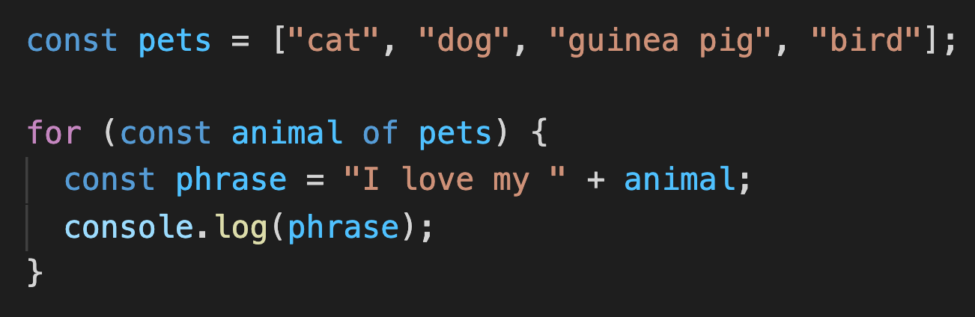
For … of …
A more “pythonic” way of iterating:
Requires the keyword of instead of in or :
Notes:
Another way of iterating, specifically for arrays and other “iterable” types.
You won’t ever actually need this, since you can just use the regular for loop syntax, but I am just putting this out there in case you see it.
One big difference from python however, is that you must use of instead of in.
I would generally caution against using this syntax, since you don’t actually need it and it is just another thing to remember. And more importantly, if you’re coming from python, you might be accustomed to typing for blank in blank. The issue is that the syntax for … in … also exists in js, but it does something completely different and you might accidentally type “in”.

Slide 34
Questions?
Comments?
Concerns?
Notes:
The next topic is

Slide 35
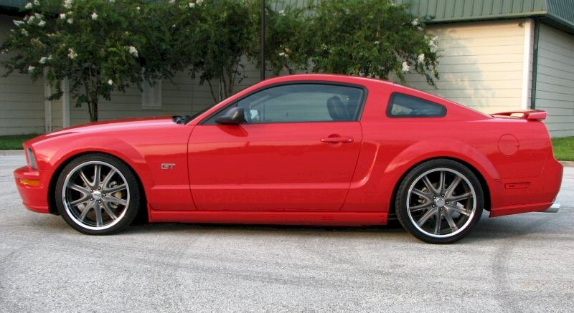
Wait, we don’t have a primitive data type for this
Notes:
If we want to store data, that’s not just one value. For example, if we wanted to store something more complicated like the data about a car, e.g. make, model, color, we have…

Slide 36
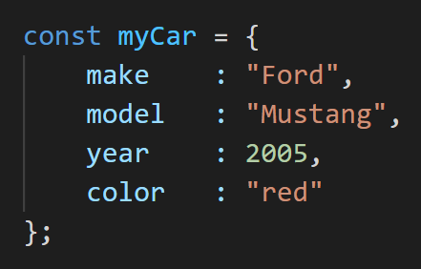
Objects
A JavaScript object is a collection of name:value pairs.
Notes:
We create objects, which are collections of properties. Each property has a name, describing what it is, and a value describing what the value of this objects property is.
Syntax: curly brace around, colons to separate names and values, and commas to separate pairs. Lets you store related data in one variable.
Can think of them as the javascript equivalent to python dictionaries
So what can we do with this

Slide 37
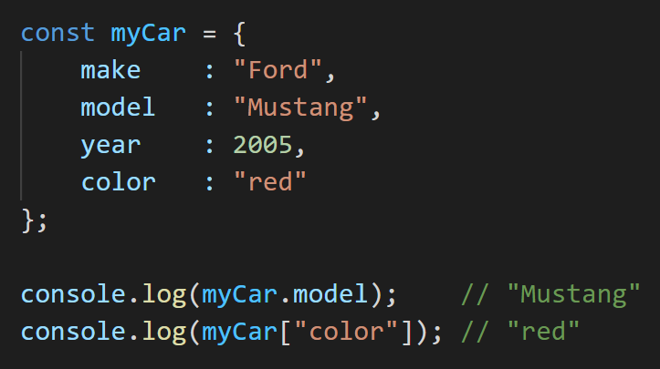
Accessing properties
There are two ways to access object properties, if you know the property name:
Notes:
If you know the property names, you can get the values

Slide 38
Object destructuring
Object destructuring is a shorthand to obtain multiple properties at once.
Notes:
Say you want to get more than one properties out of an object at once. There is a shorthand called obj destructuring. Use it to save space and make cleaner code.

Slide 39
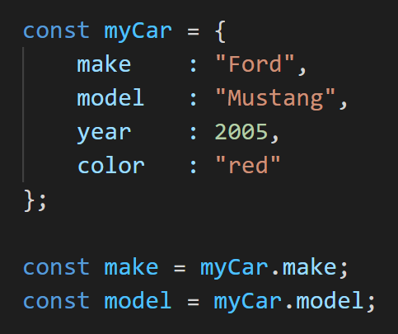
Object destructuring
Object destructuring is a shorthand to obtain multiple properties at once.
without object destructuring
Notes:
Say you want to get more than one properties out of an object at once. There is a shorthand called obj destructuring. Use it to save space and make cleaner code.

Slide 40
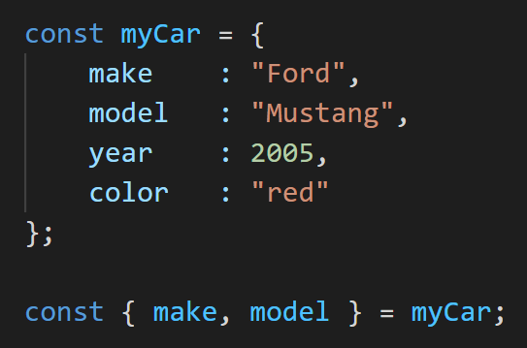
Object destructuring
Object destructuring is a shorthand to obtain multiple properties at once.
without object destructuring
with object destructuring
类似于构造函数，可以赋默认值，你甚至可以改变变量名
Notes:
Say you want to get more than one properties out of an object at once. There is a shorthand called obj destructuring. Use it to save space and make cleaner code.

Slide 41
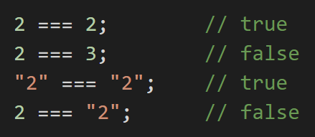
Equality...?
We use === to check if two primitive variables are equal in JavaScript.
Notes:
2 === ‘2’ is false because diff types
Use console for arr1 = [1,2,3]; arr2 = [1,2,3]; arr1 === arr2
See same behavior for arrays and objects

Slide 42
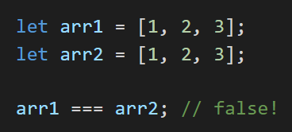
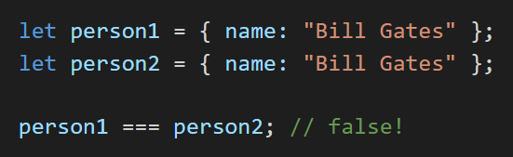
Equality...?
We use === to check if two primitive variables are equal in JavaScript.
But what does === mean for arrays and objects?
Compare the location of to object in memory !!!
Notes:
2 === ‘2’ is false because diff types
Use console for arr1 = [1,2,3]; arr2 = [1,2,3]; arr1 === arr2
See same behavior for arrays and objects

Slide 43
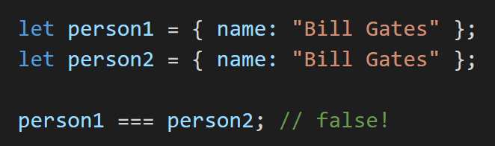
Object references
Object variables are references – they point to where the data is actually stored.
person1
person2
Object
Object
name:
“Bill Gates”
name:
“Bill Gates”
=== checks if the references are equal.
Two objects created separately are stored separately, so their references are different!
Same goes for arrays – two arrays created separately have different references.
Notes:
Object variables are references, it just points to where an object is located in memory. So when creating an array, or an object, just put this in memory and has the variable point to that object in memory. All they know is where they point to.
=== checks if references point to the same spot
Primitives check actual values, more complicated data types things just check references.

Slide 44
Object references
Object variables are references – they point to where the data is actually stored.
Notes:
Object variables are references, it just points to where an object is located in memory. So when creating an array, or an object, just put this in memory and has the variable point to that object in memory. All they know is where they point to.
=== checks if references point to the same spot
Primitives check actual values, more complicated data types things just check references.

Slide 45
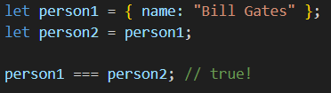
Object references
Object variables are references – they point to where the data is actually stored.
类似于别名
Notes:
Object variables are references, it just points to where an object is located in memory. So when creating an array, or an object, just put this in memory and has the variable point to that object in memory. All they know is where they point to.
=== checks if references point to the same spot
Primitives check actual values, more complicated data types things just check references.

Slide 46
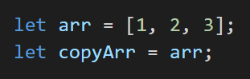
How to copy arrays and objects
It’s not as simple as
(Why not?)
Changing the copyarray will change the array at the same time
Notes:
Go into console to explain. Can mutate one. Just creating pointer to the same array.

Slide 47
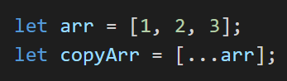
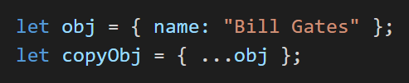
How to copy arrays and objects
It’s not as simple as
(Why not?)
One way to copy arrays and objects is to use the spread operator (...) like so:
You could also manually copy over every item / property. But where’s the fun in that?
Notes:
Go into console to explain. Can mutate one. Just creating pointer to the same array.

Slide 48
Questions?

Slide 49
Functions
Do something
Sometimes, we want the function to return an output value.
Input(s)

Slide 50
Functions
Do something
Sometimes, we want the function to return an output value.
Input(s)
JS Function Syntax:
(parameters) => { body }

Slide 51
Functions
Do something
Sometimes, we want the function to return an output value.
Input(s)
JS Function Syntax:
(parameters) => { body }
=>
{ body }
(parameters)

Slide 52
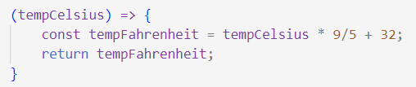
{ const tempFahrenheit = tempCelsius * 9/5 + 32;
return tempFahrenheit; }
=>
(tempCelsius)
Notes:
This is how we represent a function in JS!

Slide 53
=>
{ const tempFahrenheit = tempCelsius * 9/5 + 32;
return tempFahrenheit; }
(tempCelsius)
Notes:
What this code, as written, is doing, is it’s allotting a space in memory for this function, and then it’s storing the function in memory. So somewhere in memory we’ve recorded the ability to take in an integer temperature, and do this calculation and return the result. But in order to actually use this function, there’s something we’re missing.

Slide 54
=>
{ const tempFahrenheit = tempCelsius * 9/5 + 32;
return tempFahrenheit; }
(tempCelsius)
What do we need to add so we can call this function?

Slide 55
=>
{ const tempFahrenheit = tempCelsius * 9/5 + 32;
return tempFahrenheit; }
celsiusToFahrenheit
(tempCelsius)
Notes:
We need to give it a name! We need a name that points to the location in memory where we stored the function. So let’s call it celsius to Fahrenheit.

Slide 56
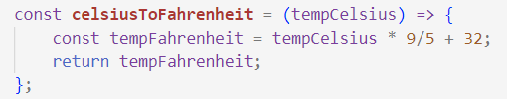
=>
{ const tempFahrenheit = tempCelsius * 9/5 + 32;
return tempFahrenheit; }
celsiusToFahrenheit
(tempCelsius)
Notes:
And in JS, we do this by assigning the function to a variable. Notice that the syntax here is exactly the same as any other variable: we have const, which means we’re not going to change what this variable points to, then the variable name, then the equals sign. Then we have the value that we want the variable to point to, which in this case is our function, and then a semicolon. So it’s just a variable.

Slide 57
=>
{ const tempFahrenheit = tempCelsius * 9/5 + 32;
return tempFahrenheit; }
celsiusToFahrenheit
(tempCelsius)
We must add const to make the variable can’t be reassigned
Notes:
And in JS, we do this by assigning the function to a variable. Notice that the syntax here is exactly the same as any other variable: we have const, which means we’re not going to change what this variable points to, then the variable name, then the equals sign. Then we have the value that we want the variable to point to, which in this case is our function, and then a semicolon. So it’s just a variable.

Slide 58
=>
{ const tempFahrenheit = tempCelsius * 9/5 + 32;
return tempFahrenheit; }
celsiusToFahrenheit
(tempCelsius)
Notes:
And in JS, we do this by assigning the function to a variable. Notice that the syntax here is exactly the same as any other variable: we have const, which means we’re not going to change what this variable points to, then the variable name, then the equals sign. Then we have the value that we want the variable to point to, which in this case is our function, and then a semicolon. So it’s just a variable.

Slide 59
=>
{ const tempFahrenheit = tempCelsius * 9/5 + 32;
return tempFahrenheit; }
celsiusToFahrenheit
(tempCelsius)
Notes:
And in JS, we do this by assigning the function to a variable. Notice that the syntax here is exactly the same as any other variable: we have const, which means we’re not going to change what this variable points to, then the variable name, then the equals sign. Then we have the value that we want the variable to point to, which in this case is our function, and then a semicolon. So it’s just a variable.

Slide 60
=>
{ const tempFahrenheit = tempCelsius * 9/5 + 32;
return tempFahrenheit; }
celsiusToFahrenheit
(tempCelsius)
Notes:
And in JS, we do this by assigning the function to a variable. Notice that the syntax here is exactly the same as any other variable: we have const, which means we’re not going to change what this variable points to, then the variable name, then the equals sign. Then we have the value that we want the variable to point to, which in this case is our function, and then a semicolon. So it’s just a variable.

Slide 61
=>
{ const tempFahrenheit = tempCelsius * 9/5 + 32;
return tempFahrenheit; }
celsiusToFahrenheit
(tempCelsius)
Functions are values stored in memory, just like strings, ints, etc. So we can assign variables to point to them!
Notes:
And in JS, we do this by assigning the function to a variable. Notice that the syntax here is exactly the same as any other variable: we have const, which means we’re not going to change what this variable points to, then the variable name, then the equals sign. Then we have the value that we want the variable to point to, which in this case is our function, and then a semicolon. So it’s just a variable.

Slide 62
=>
{ const tempFahrenheit = tempCelsius * 9/5 + 32;
return tempFahrenheit; }
celsiusToFahrenheit
(tempCelsius)

Slide 63
Callback functions
In JavaScript, functions can be passed around like any other values.
This means we can give a “callback” function as an argument to another function!

Slide 64
Quick Practice!
Write a function that prints a simple message to the console.
Syntax reference:
(parameters) => { body } (but we don’t need any parameters)
console.log(“your message”);
Remember to give your function a name!

Slide 65
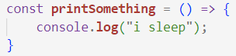
Example: setTimeout
setTimeout() calls a function after a specified delay. It takes 2 parameters: the function to call (aka callback function), and the delay (in milliseconds).

Slide 66
Example: setTimeout
setTimeout() calls a function after a specified delay. It takes 2 parameters: the function to call (aka callback function), and the delay (in milliseconds).
How can we print our message after 5 seconds? (multiple-select)
A.
B.
C.

Slide 67
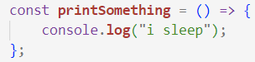
Example: setTimeout
setTimeout() calls a function after a specified delay. It takes 2 parameters: the function to call, and the delay (in milliseconds).
How can we print our message after 5 seconds?
A.
B.
C.
DON’T DO THIS! printSomething() is whatever printSomething returns, not the function itself

Slide 68
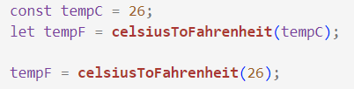
What’s going on in Option C?
These are equivalent…

Slide 69
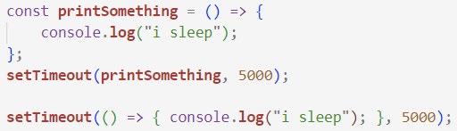
What’s going on in Option C?
These are equivalent…
And so are these!

Slide 70
What’s going on in Option C?
These are equivalent…
And so are these!
(the highlighted parts are the same)

Slide 71
setInterval() vs. setTimeout()
Check out MDN docs for more info!
setInterval()
Repeatedly calls a function with a delay between each call
Returns an intervalID which can be passed into clearInterval() to terminate
Arguments: func, delay, arg0, …, argN
setTimeout()
Sets a timer that executes a function when the timer ends
Returns an intervalID which can be passed into clearTimeout() to cancel the timer
Arguments: func, delay, arg0, …, argN

Slide 72

Classes
Classes are used when we have multiple objects that all represent the same type of thing. They let us define the attributes
and methods
that every object of that type, or class, has.
Notes:
Classes are not really used in weblab! So do not worry about this!

Slide 73
JS Practice
Some simple exercises to practice JavaScript:
https://www.jschallenger.com/javascript-practice

Slide 74
Feedback Time!
weblab.is/feedback

Slide 75
Announcements
📝Hw0 (Setup): weblab.is/hw0
Need to install Node by tomorrow!
🧠Office Hours tonight 7-9pm in 32-082 (stata basement) !
Come for setup issues, or if you’re new to programming and want to go over javascript or git!
🪧Milestone 0 (find a team and brainstorm 10 ideas) due eod Wednesday
💛Need a team? Team formation mixer in a couple min! Join weblab.is/zoom
🎦Recordings from today will be available as soon as we edit + post them (hopefully this evening). Slides are all available at weblab.is/schedule and weblab.is/slides

